Slide 1

House Price Prediction Model
06.12.2022
Tayfun Kok

Slide 2

My Goal?
Developing a machine learning model to predict the price of a house based on its characteristics such as location, age, number of rooms, etc.
Implementing linear regression model.

Slide 3

Use Case
No bank wants to lend more than the real value of the house
The bank does not immediately give you the home loan you want to take out even if your credit score is sufficient.
The bank first assesses the real value of the house.
Then gives a home loan according to the real value.

Slide 4

Use Case
The bank can use the model developed in this project to calculate the real value of the house the customer wants to buy
For example, this model works like this
The customer enters the characteristics of the house such as location, number of rooms, age, etc. into the application.
Then the application tells the customer how much loan they can get from the bank for this house.

Slide 5
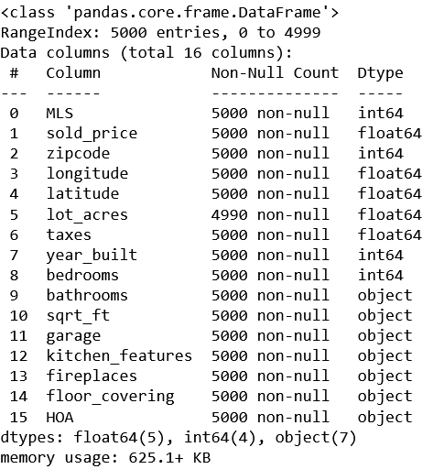
Recognizing and Understanding Data
The shape of the dataset : (5000,16)
Longitudes : vertical lines that measure east or west of the meridian in Greenwich, England.
Latitudes : horizontal lines that measure distance north or south of the equator
"lot_acres" column contains 10 null values also there are some empty values needed to be filled
There were outliers and messy values needed to be cleaned.

Slide 6
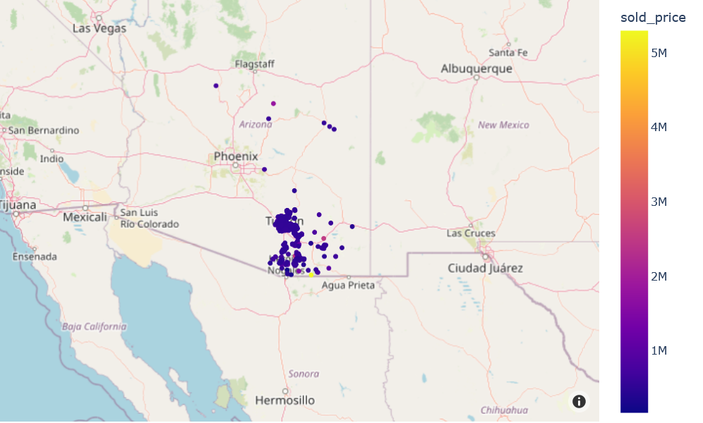
Distribution of the houses on the map : Before cleaned the data

Slide 7
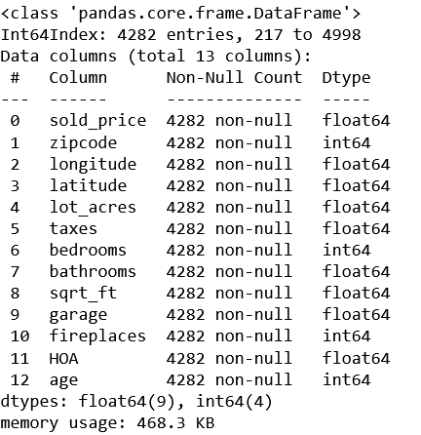
The Cleaned Data
Dropped "MLS", "kitchen_features" and "floor_covering" columns.
Filled null and empty values with suitable values.
Cleaned Outliers and messy values.
Created "age" column based on 2019.
The shape of the cleaned data : (4282,13)

Slide 8
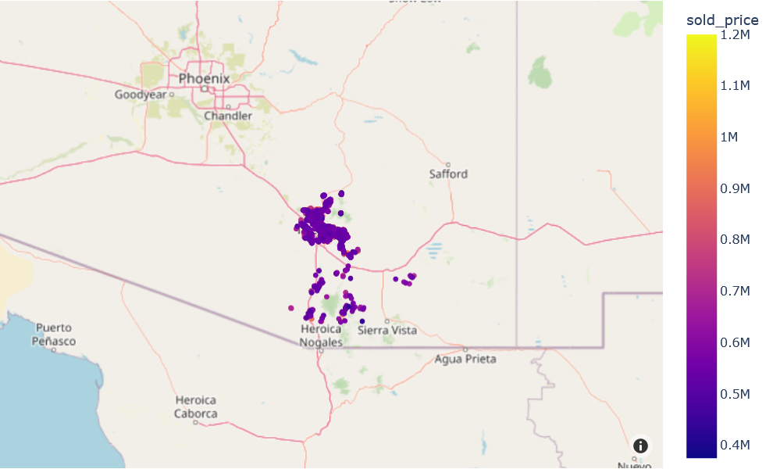
Distribution of the houses on the map : After cleaned the data

Slide 9

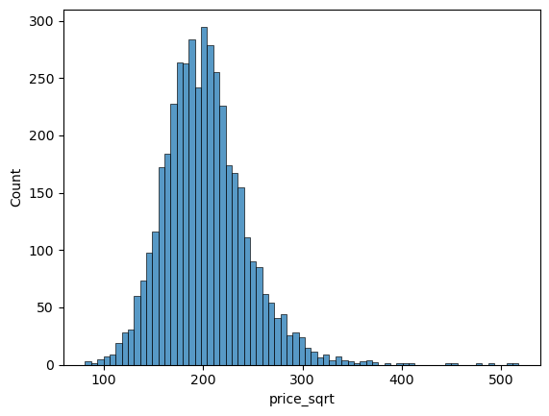
Feature Engineering :
Created "price_sqrt" column
Price_sqrt=sold_price/sqrt_ft
price_sqrt : distribution between 100 and 300

Slide 10
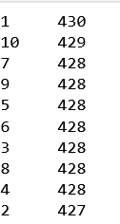
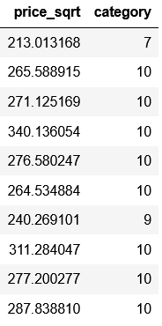
Feature Engineering :
Divided it into ten equal groups according to the values of price_sqrt
Numbered these groups from 1 to 10.
For example:
81-153 -> 1
53-168 -> 2
.
.
253-517 -> 10

Slide 11
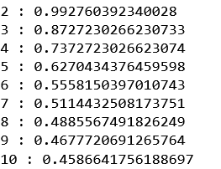
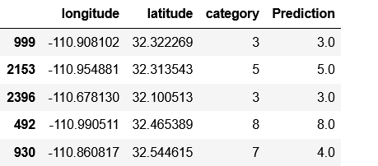
Classification : KNN
Accuracy : 0.87
K=3

Slide 12
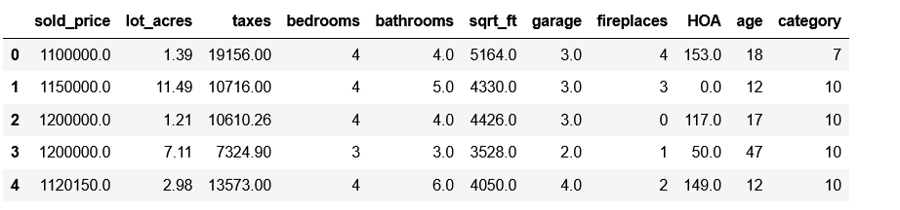
Model Building : Linear Regression
Split the data as train and test data.
Train size : (3853, 10)
Test Size : (429, 10)
Normalized the data.
Trained the model with the train data.

Slide 13
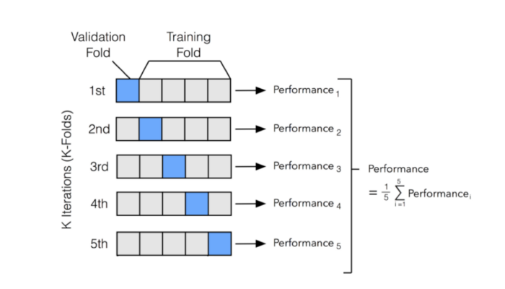
Cross Validation

Slide 14
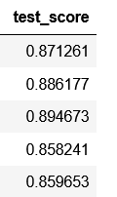
The Model Performance
R2 score of the train data : 0.875
R2 score of the cross validation : 0.874
R2 score of the test data: 0.88
Train and validation score are almost the same so there is not overfitting.

Slide 15
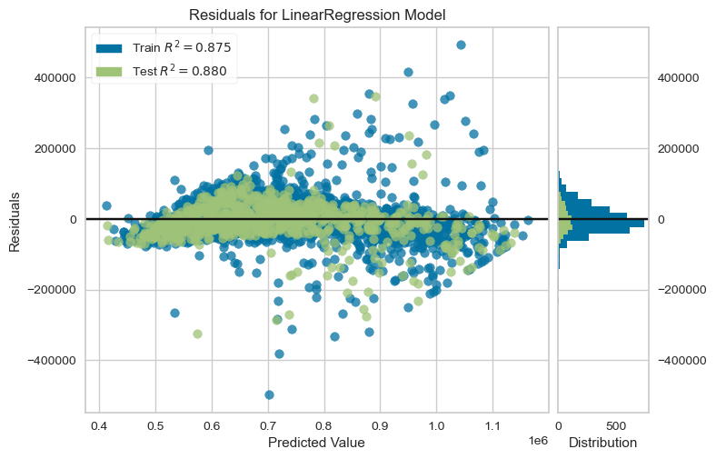
Distribution of the Residuals

Slide 16
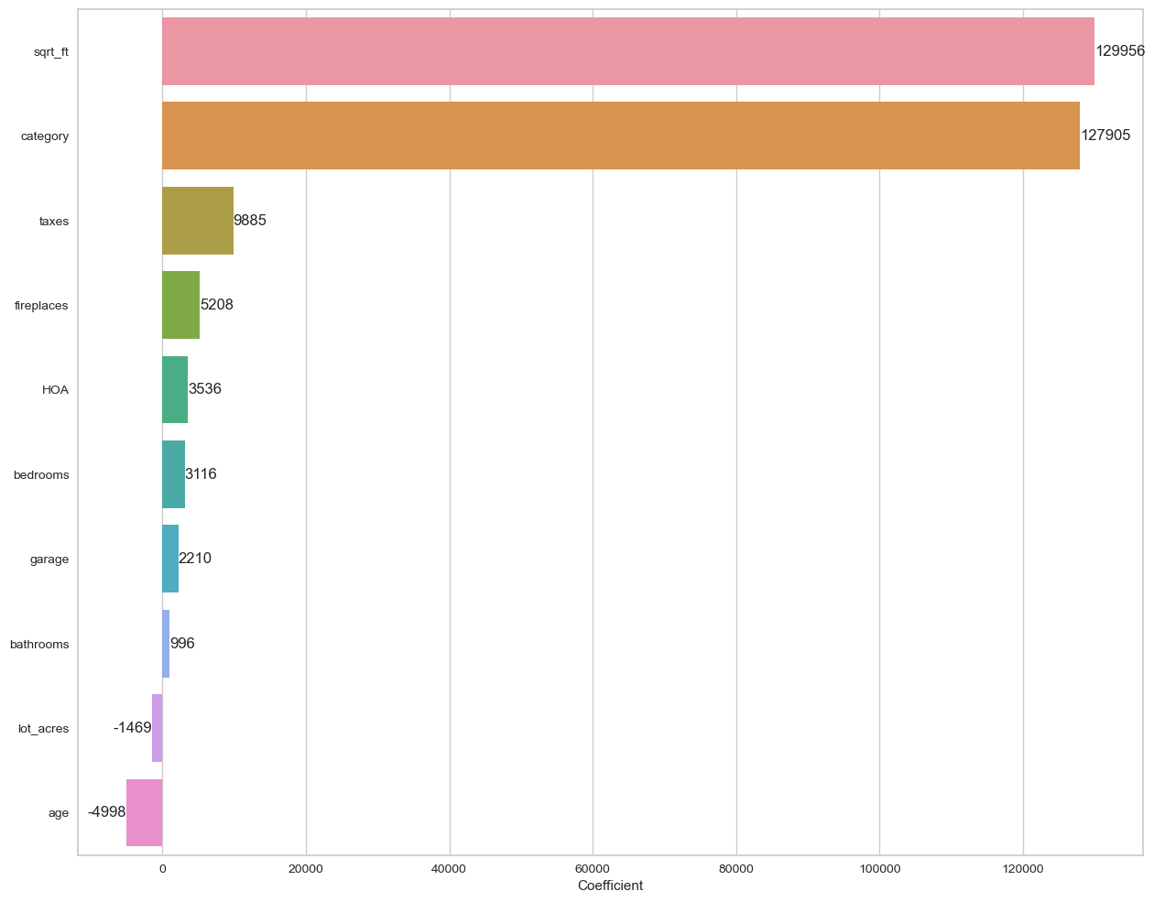
Coefficients

Slide 17
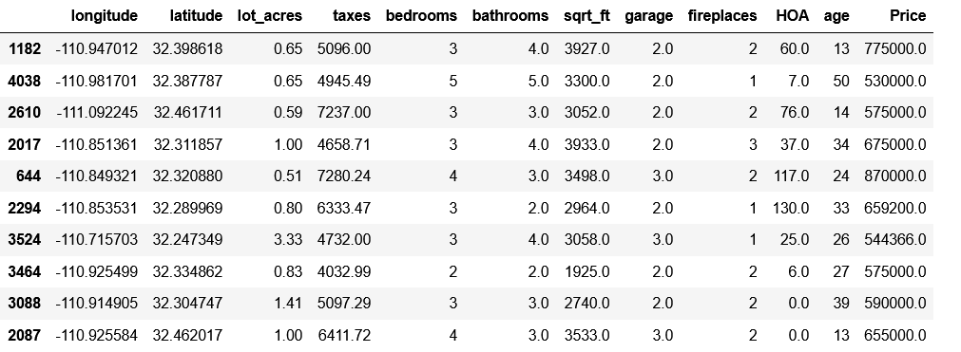
Prediction

Slide 18
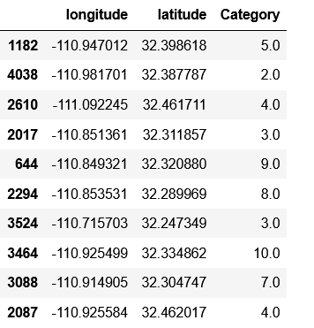
Prediction : Category
Predicted categories with KNN.
Drop longitude and Latitude columns and add category column to the sample data.

Slide 19
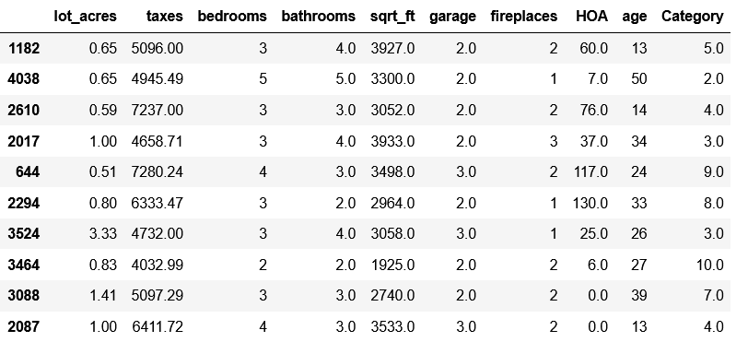
Prediction

Slide 20
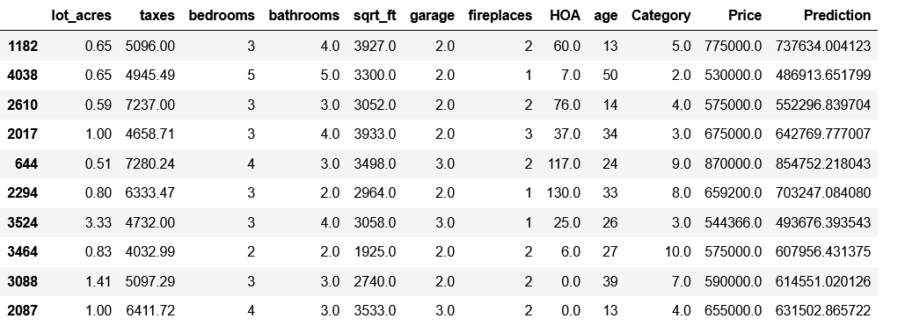
Prediction : Price

Slide 21
Conclusion
Achieved a performance of 88 percent with linear regression.
Means that our model knows house prices with a margin of error of 12 percent.
For example, if the real price of the house is 1.000.000, the model estimates it between 880.000 and 1.120.000.
This result is not bad but better performance can be achieved with bagging and boosting models like random forest and XGBoost.

Slide 22


